Slide 1
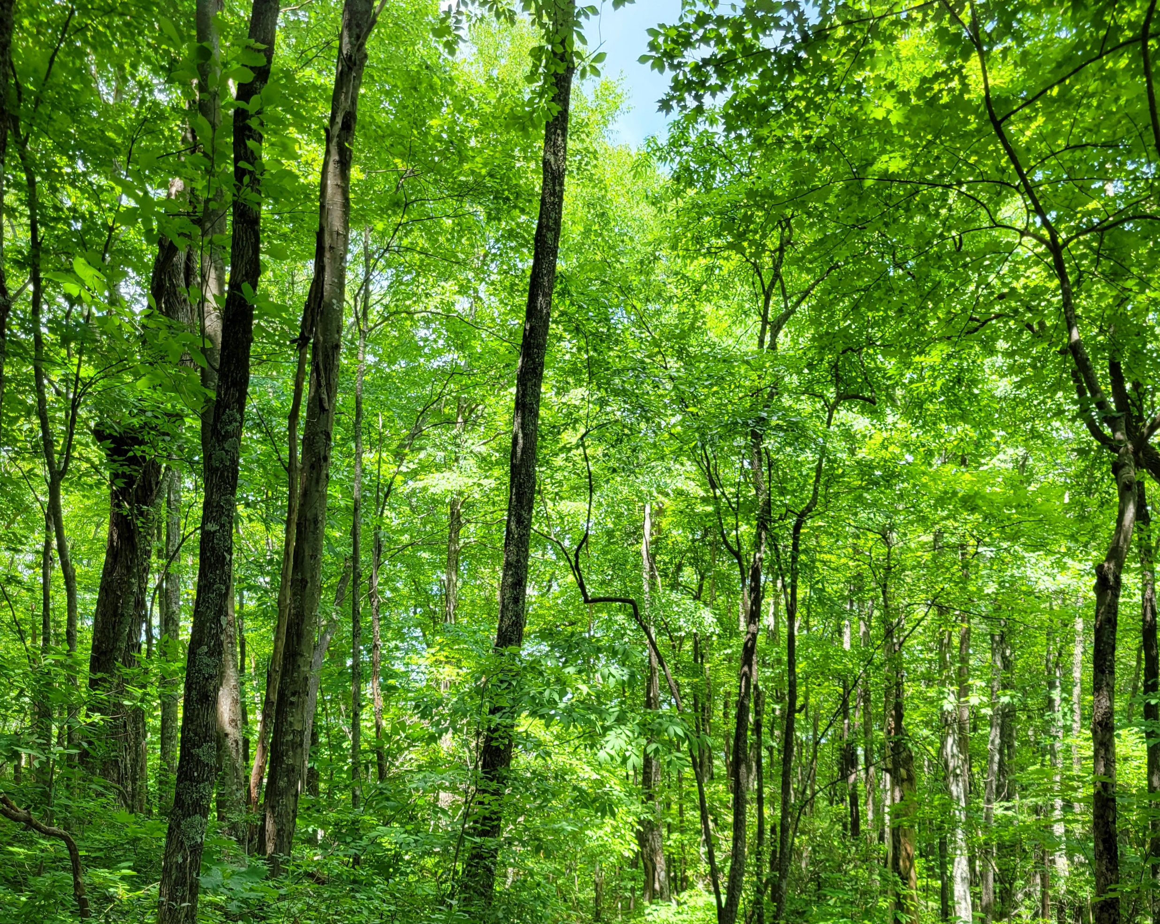
Regulation of nonstructural carbohydrate dynamics
Biological Insights from a Mathematical Analysis
Scott W Oswald, Doug P. Aubrey, Dan M. Ricciuto, Jeff M. Warren
Ecological Society of America, Montréal, QC
August 18, 2022

Slide 2
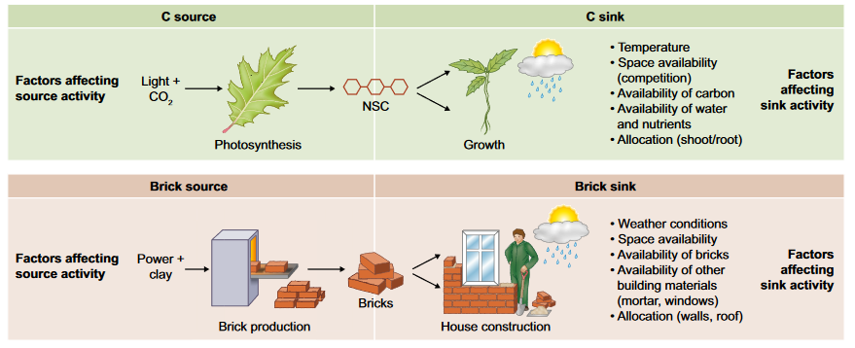
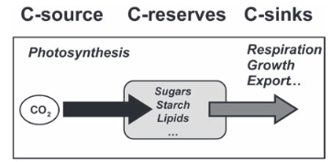
Fig 1. Fatichi et al. 2019
Nonstructural Carbohydrates = NSC
Sala et al. 2011; Sala et al. 2012

Slide 3
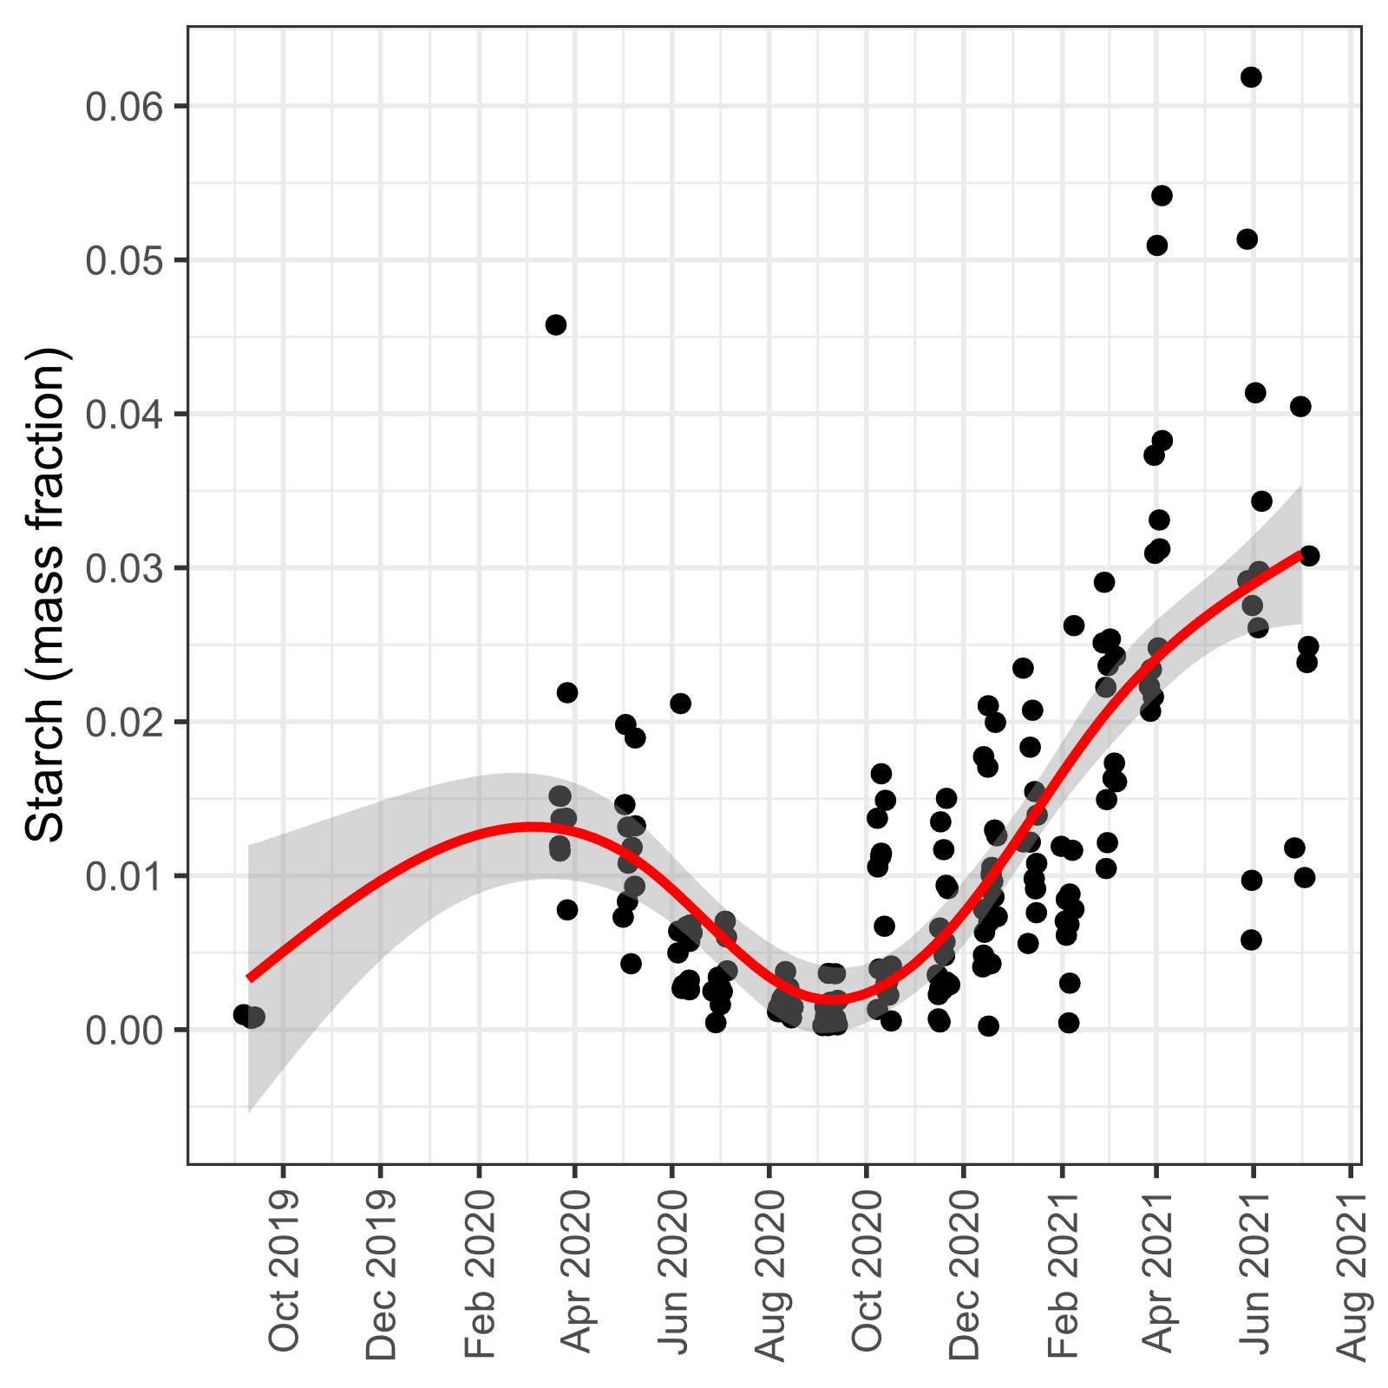
From here to there…

Slide 4
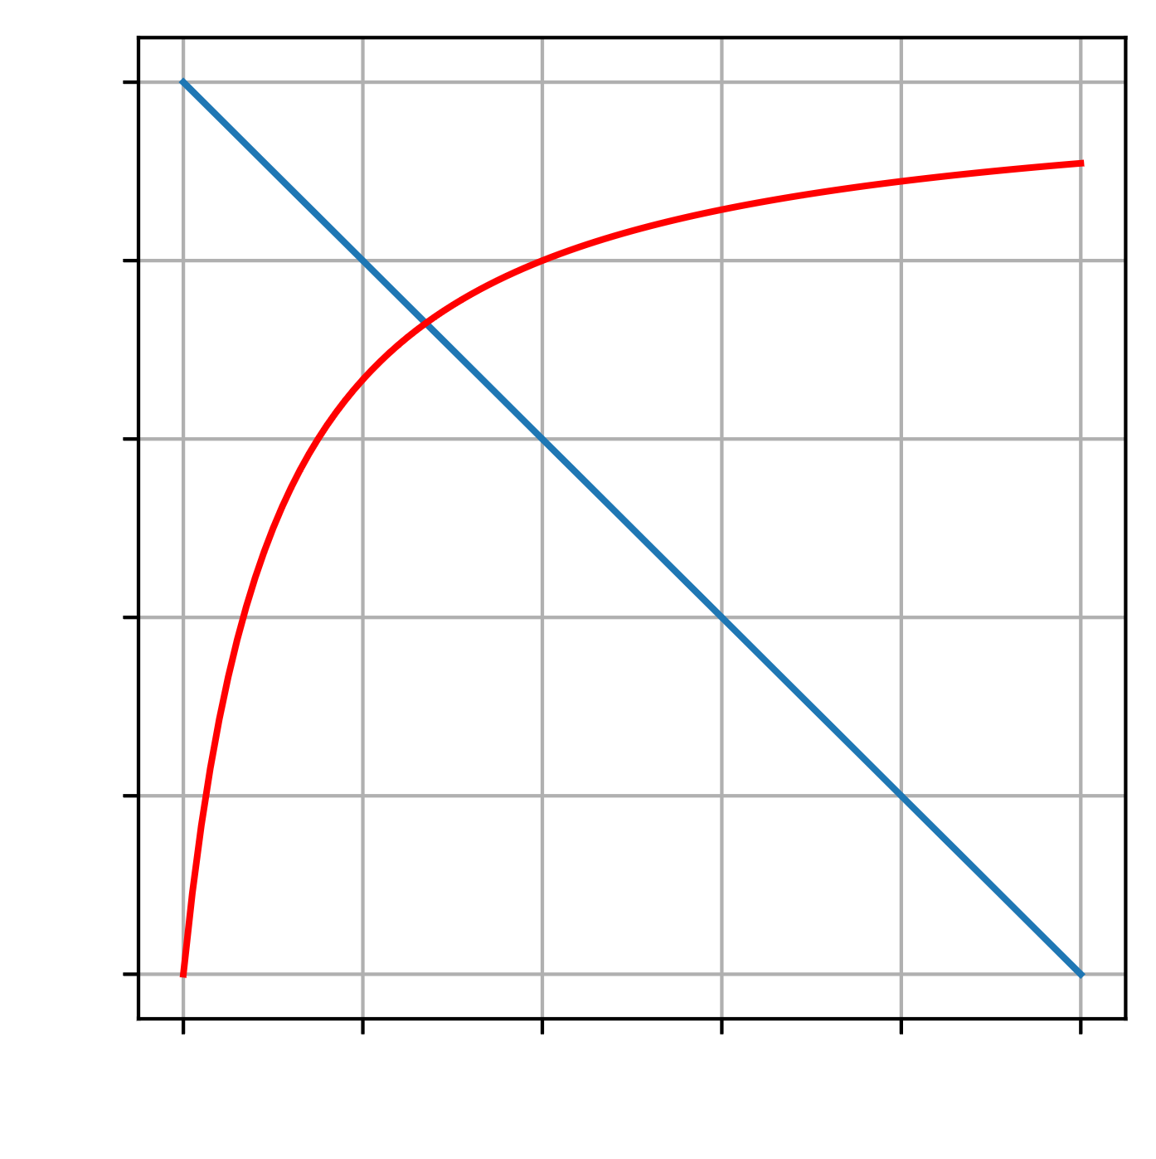
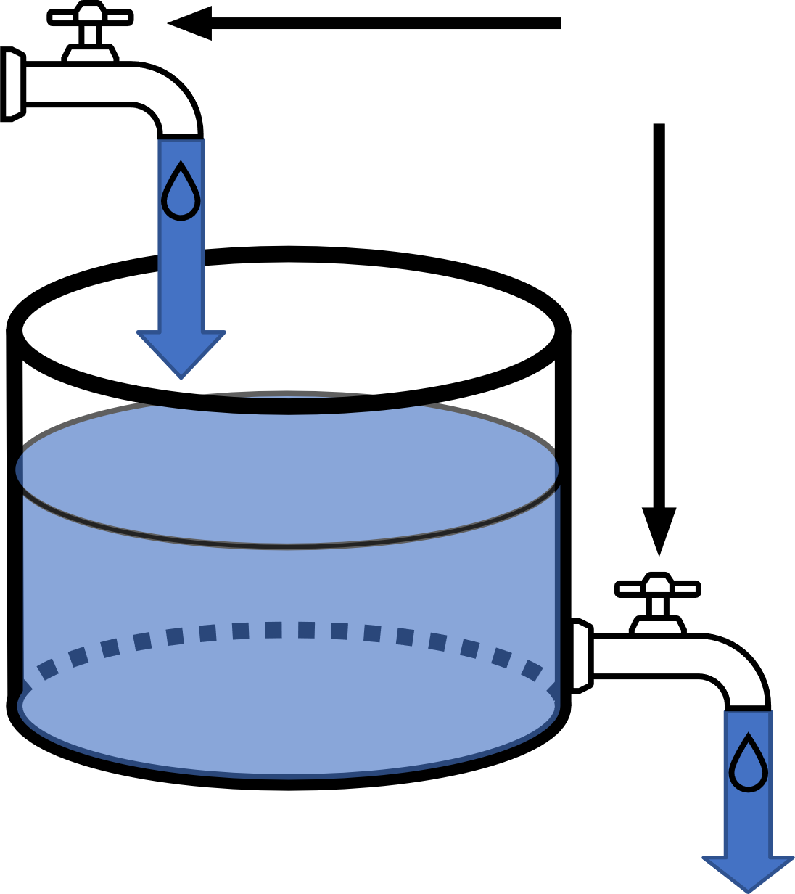
Photosynthesis
Demand Rate
Adjustable
Rate
Supply Rate
NSC
Respiration + Growth
NSC

Slide 5
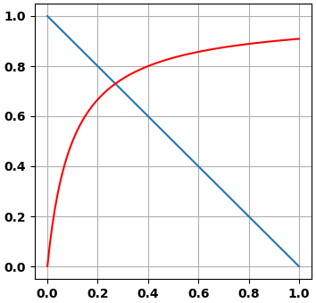
Photosynthesis
Adjustable
Rate
NSC
Respiration + Growth
NSC

Slide 6
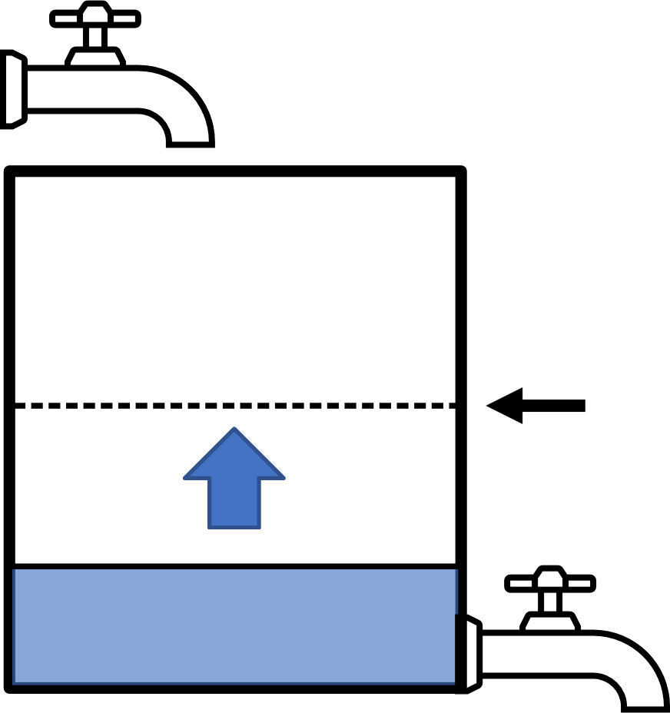
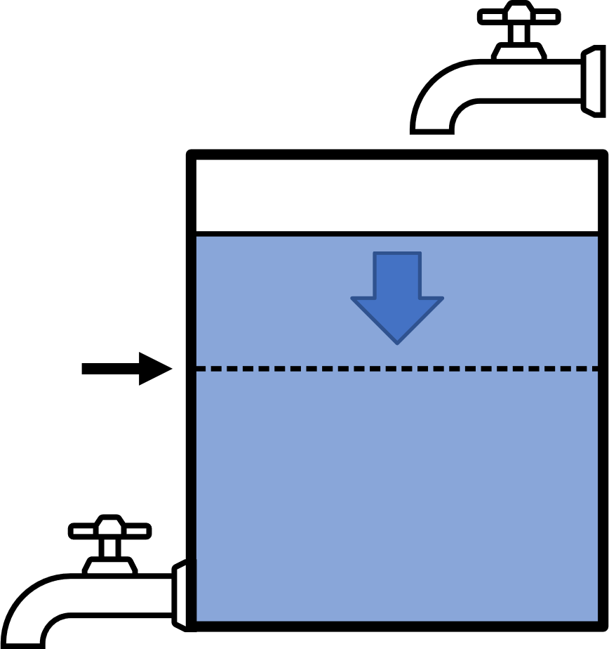
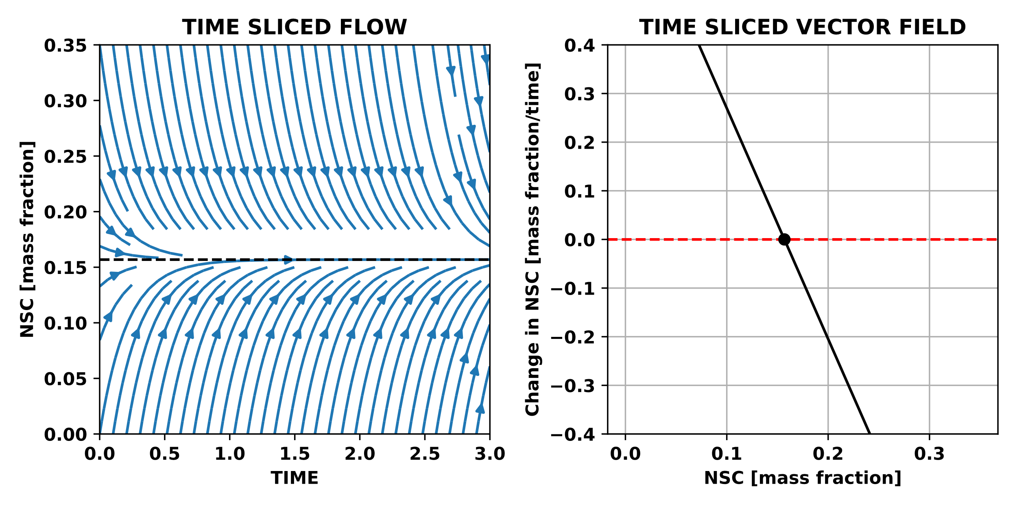
Balance point
Demand Rate
Rate
Supply Rate
Balance point
NSC

Slide 7
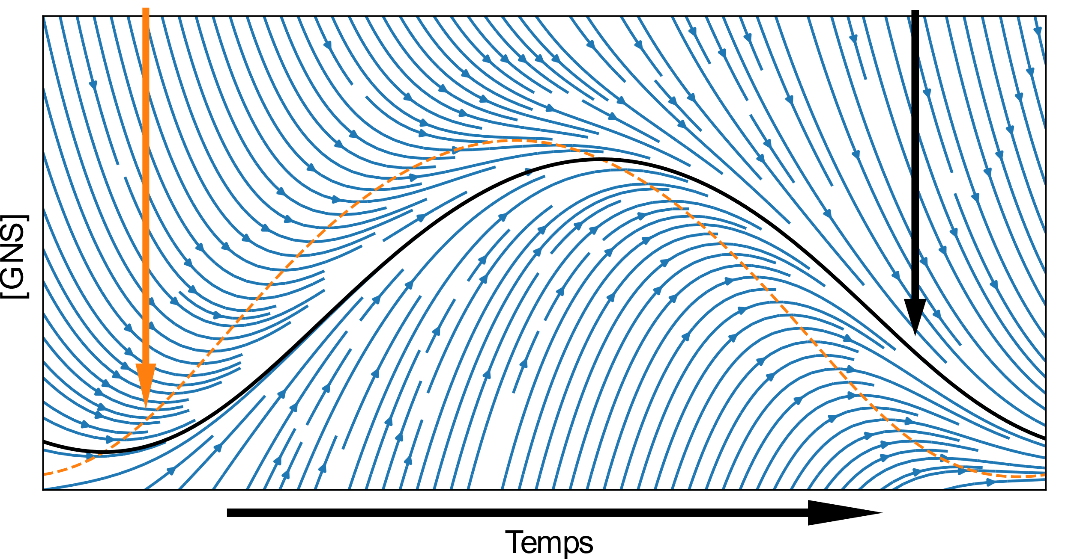
Balance point
Attractor
[NSC]
Time

Slide 8
Supply driven
Demand driven

Slide 9
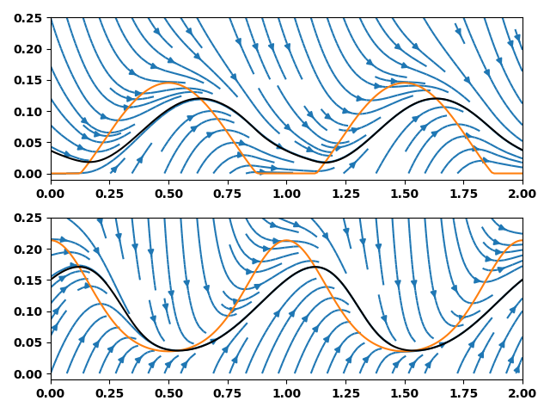
Balance point
Attractor
Supply driven
NSC (mass fraction)
Demand driven
Time (y)

Slide 10
Supply driven
Demand driven
Early growing season min
Late growing season min

Slide 12
Balance point
Attractor
[NSC]
Time

Slide 13
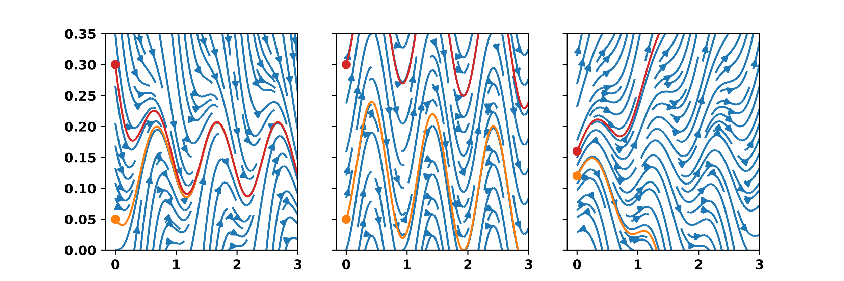
Stable
NSC (mass fraction)
Time (y)

Slide 14
Stable
Non Stable
NSC (mass fraction)
Time (y)
Time (y)

Slide 15
Stable
Non Stable
Unstable
NSC (mass fraction)
Time (y)

Slide 16
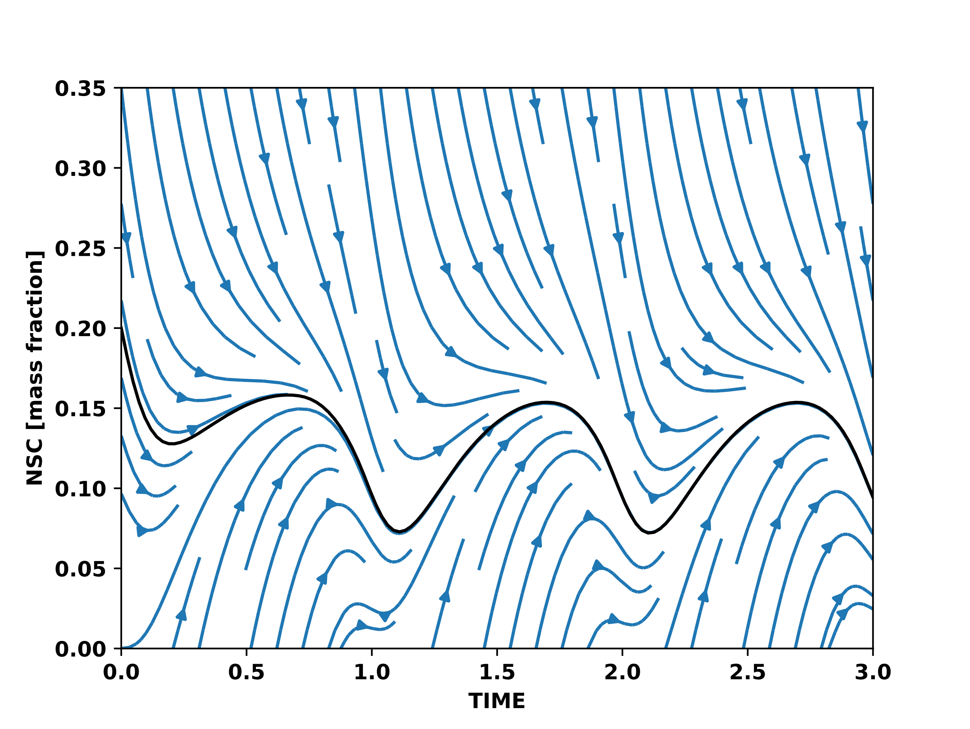
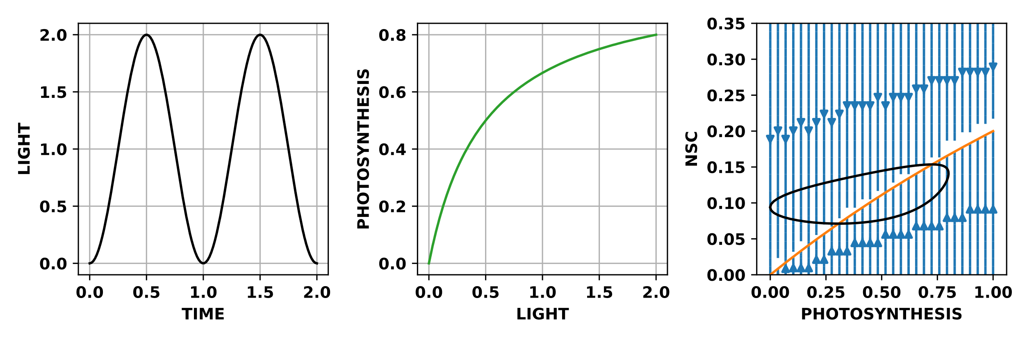
Stable for all environments

Slide 17
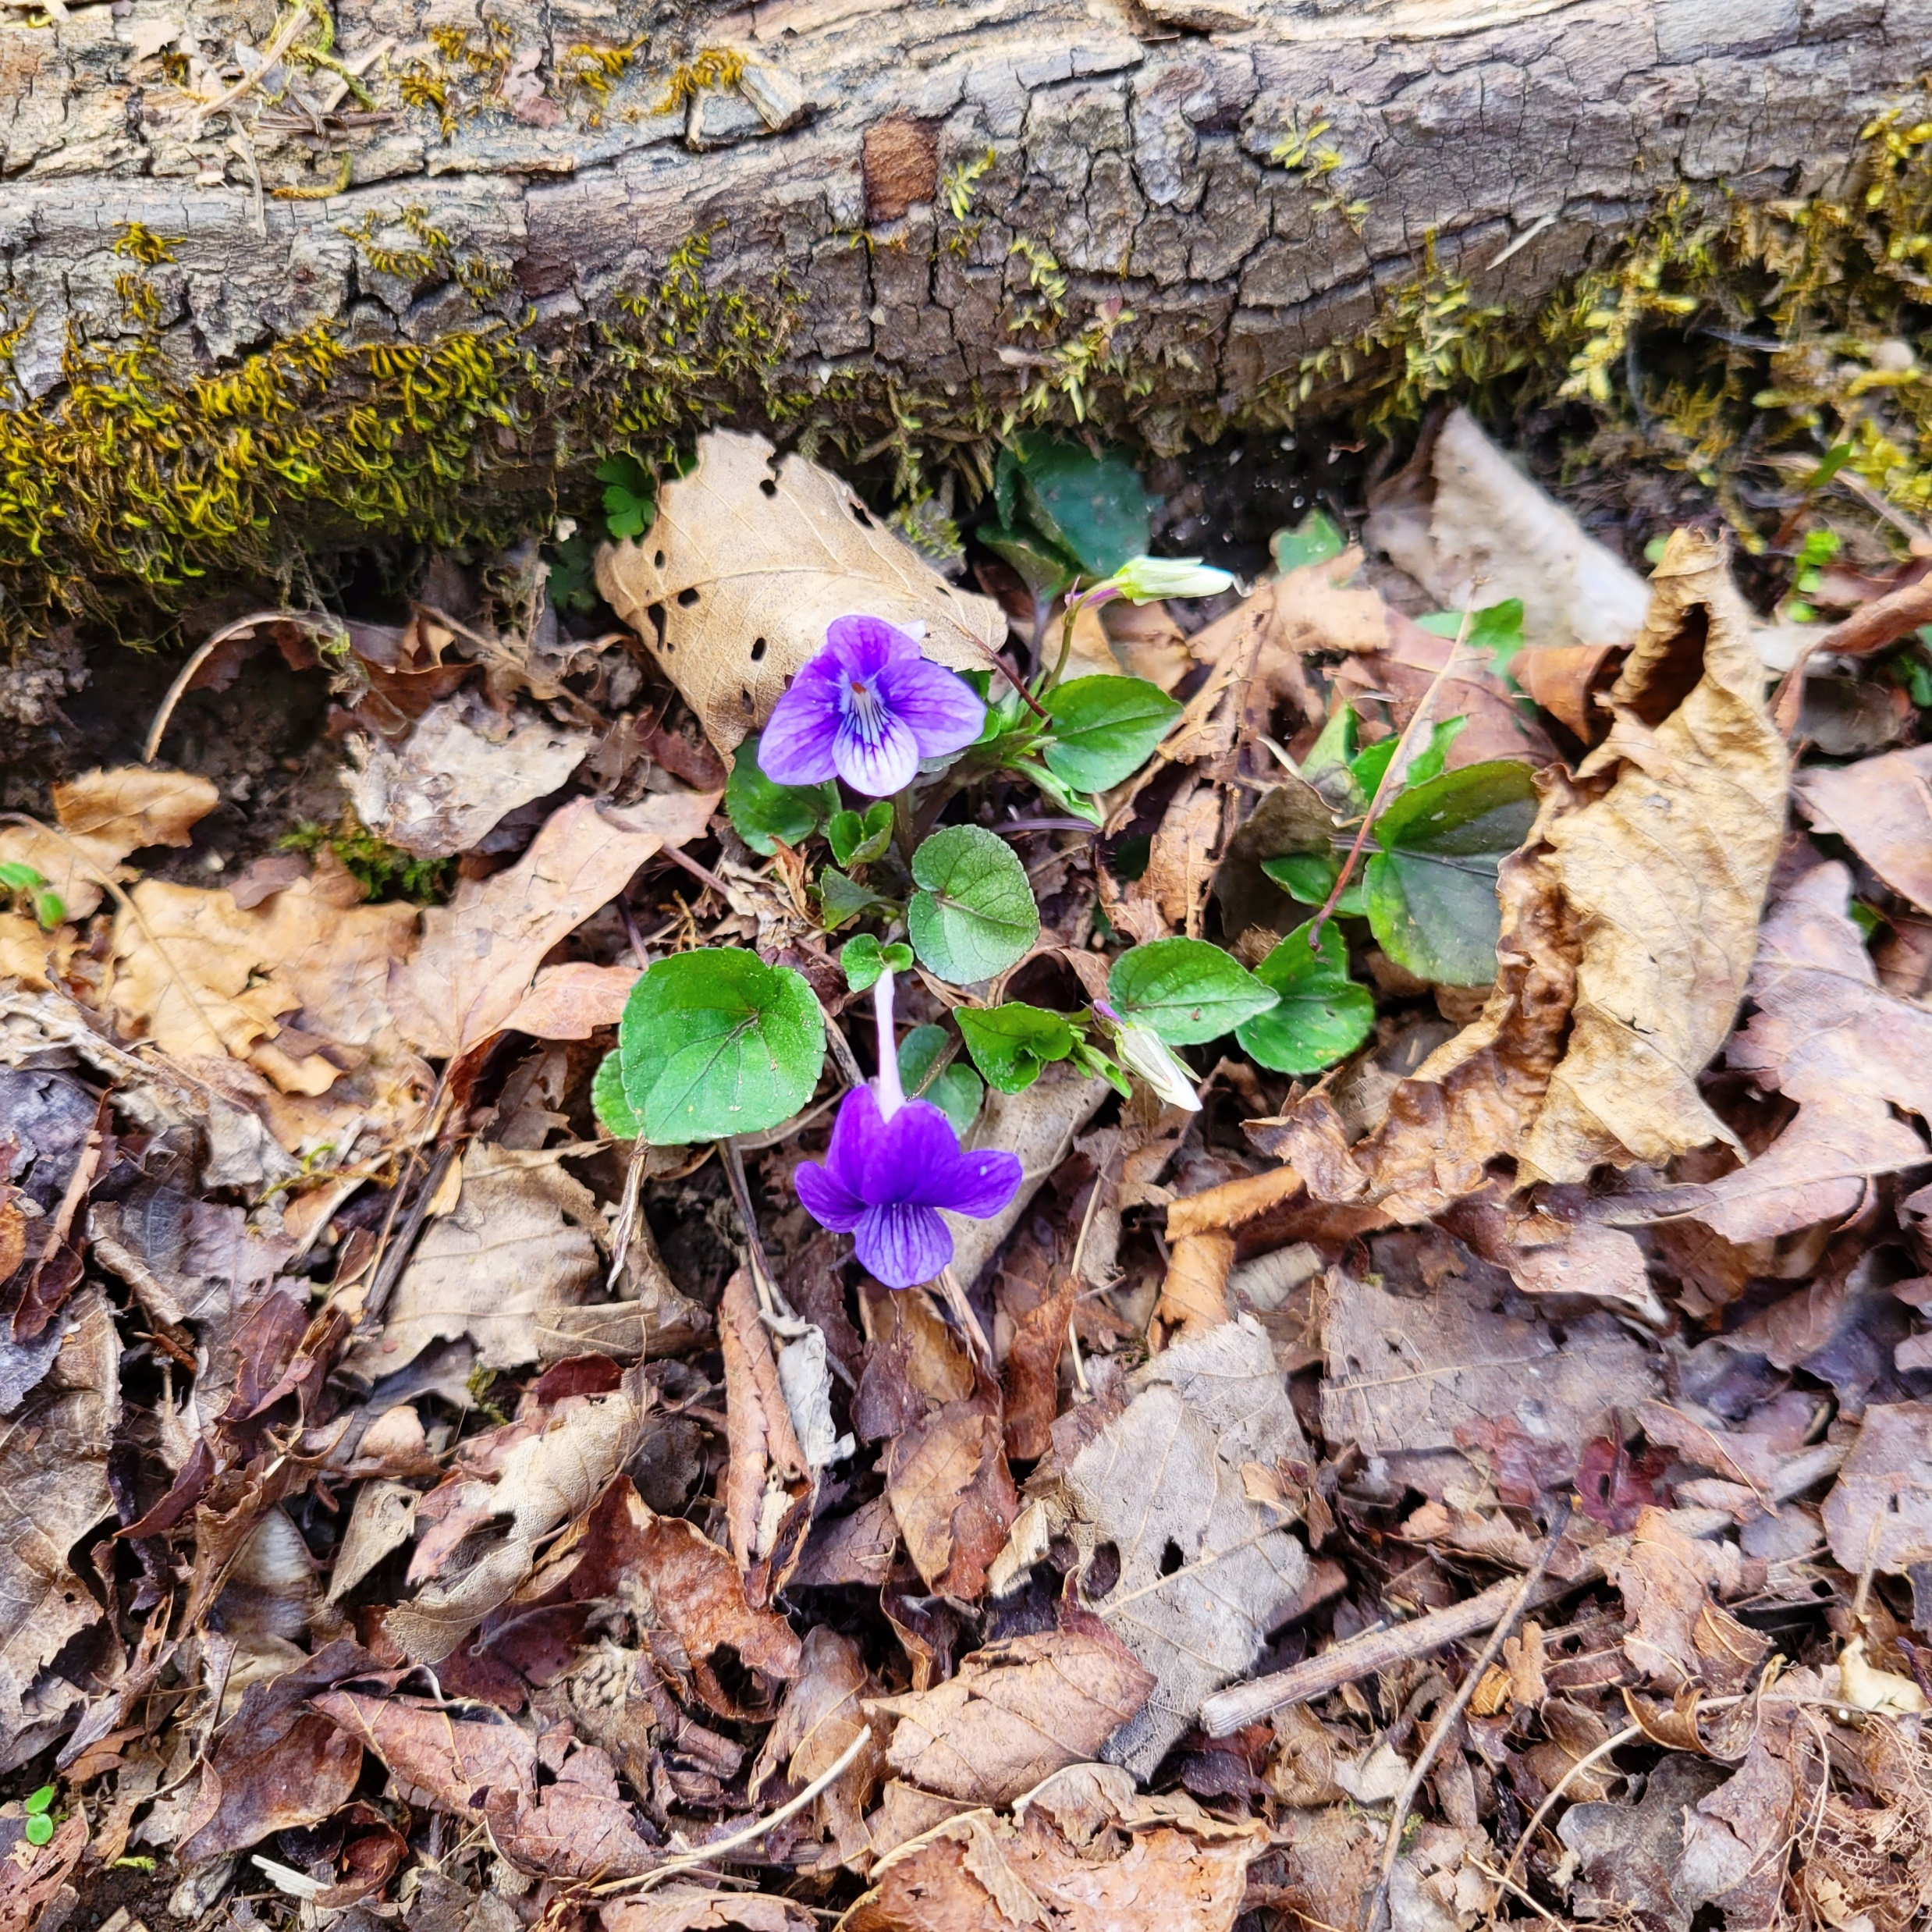
Summary
Stability → Attractor
Attractor → NSC feedback
Complex environment
→ Complex attractor

Slide 18
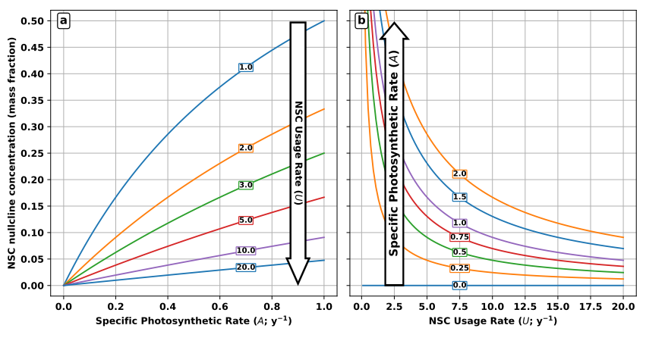
NSC balance point (mass fraction)

Slide 19
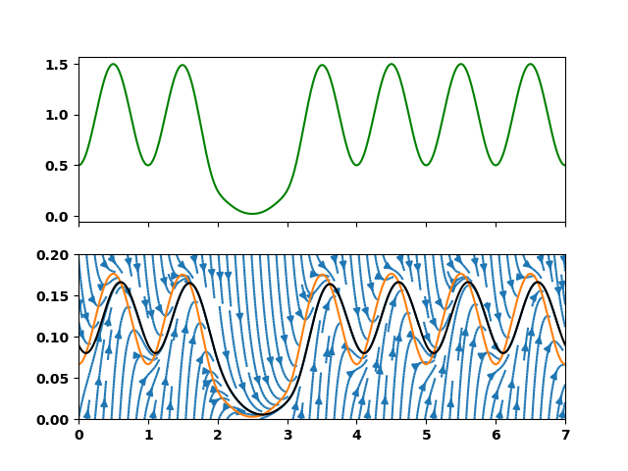
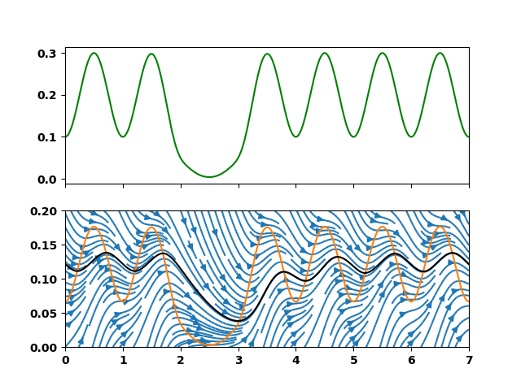
Supply rate
NSC (mass fraction)
Slower rate of supply and demand

Slide 20
NSC balance point (mass fraction)

Slide 21
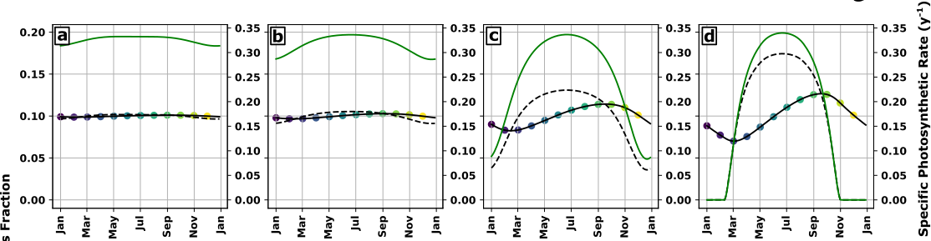
NSC (mass fraction)
Increasing seasonal amplitude of NSC supply

Slide 22
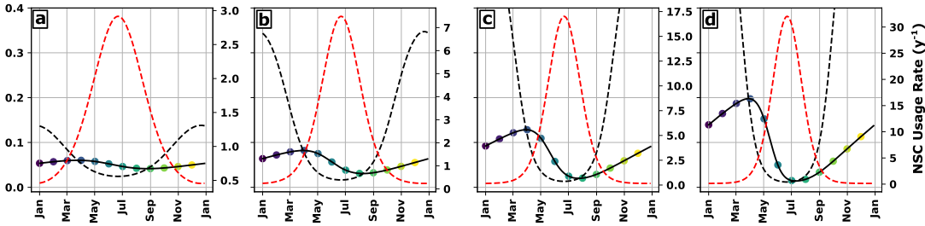
NSC (mass fraction)
Increasing seasonal amplitude of NSC demand

Slide 23
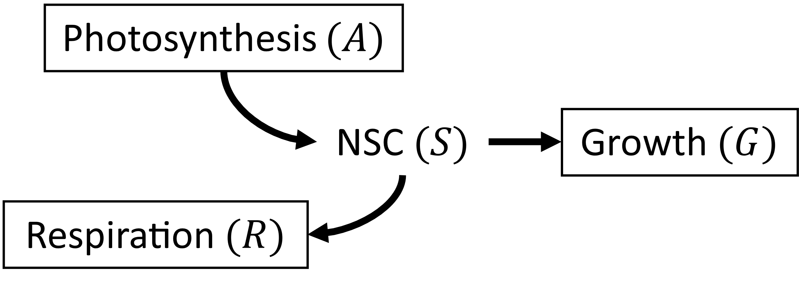
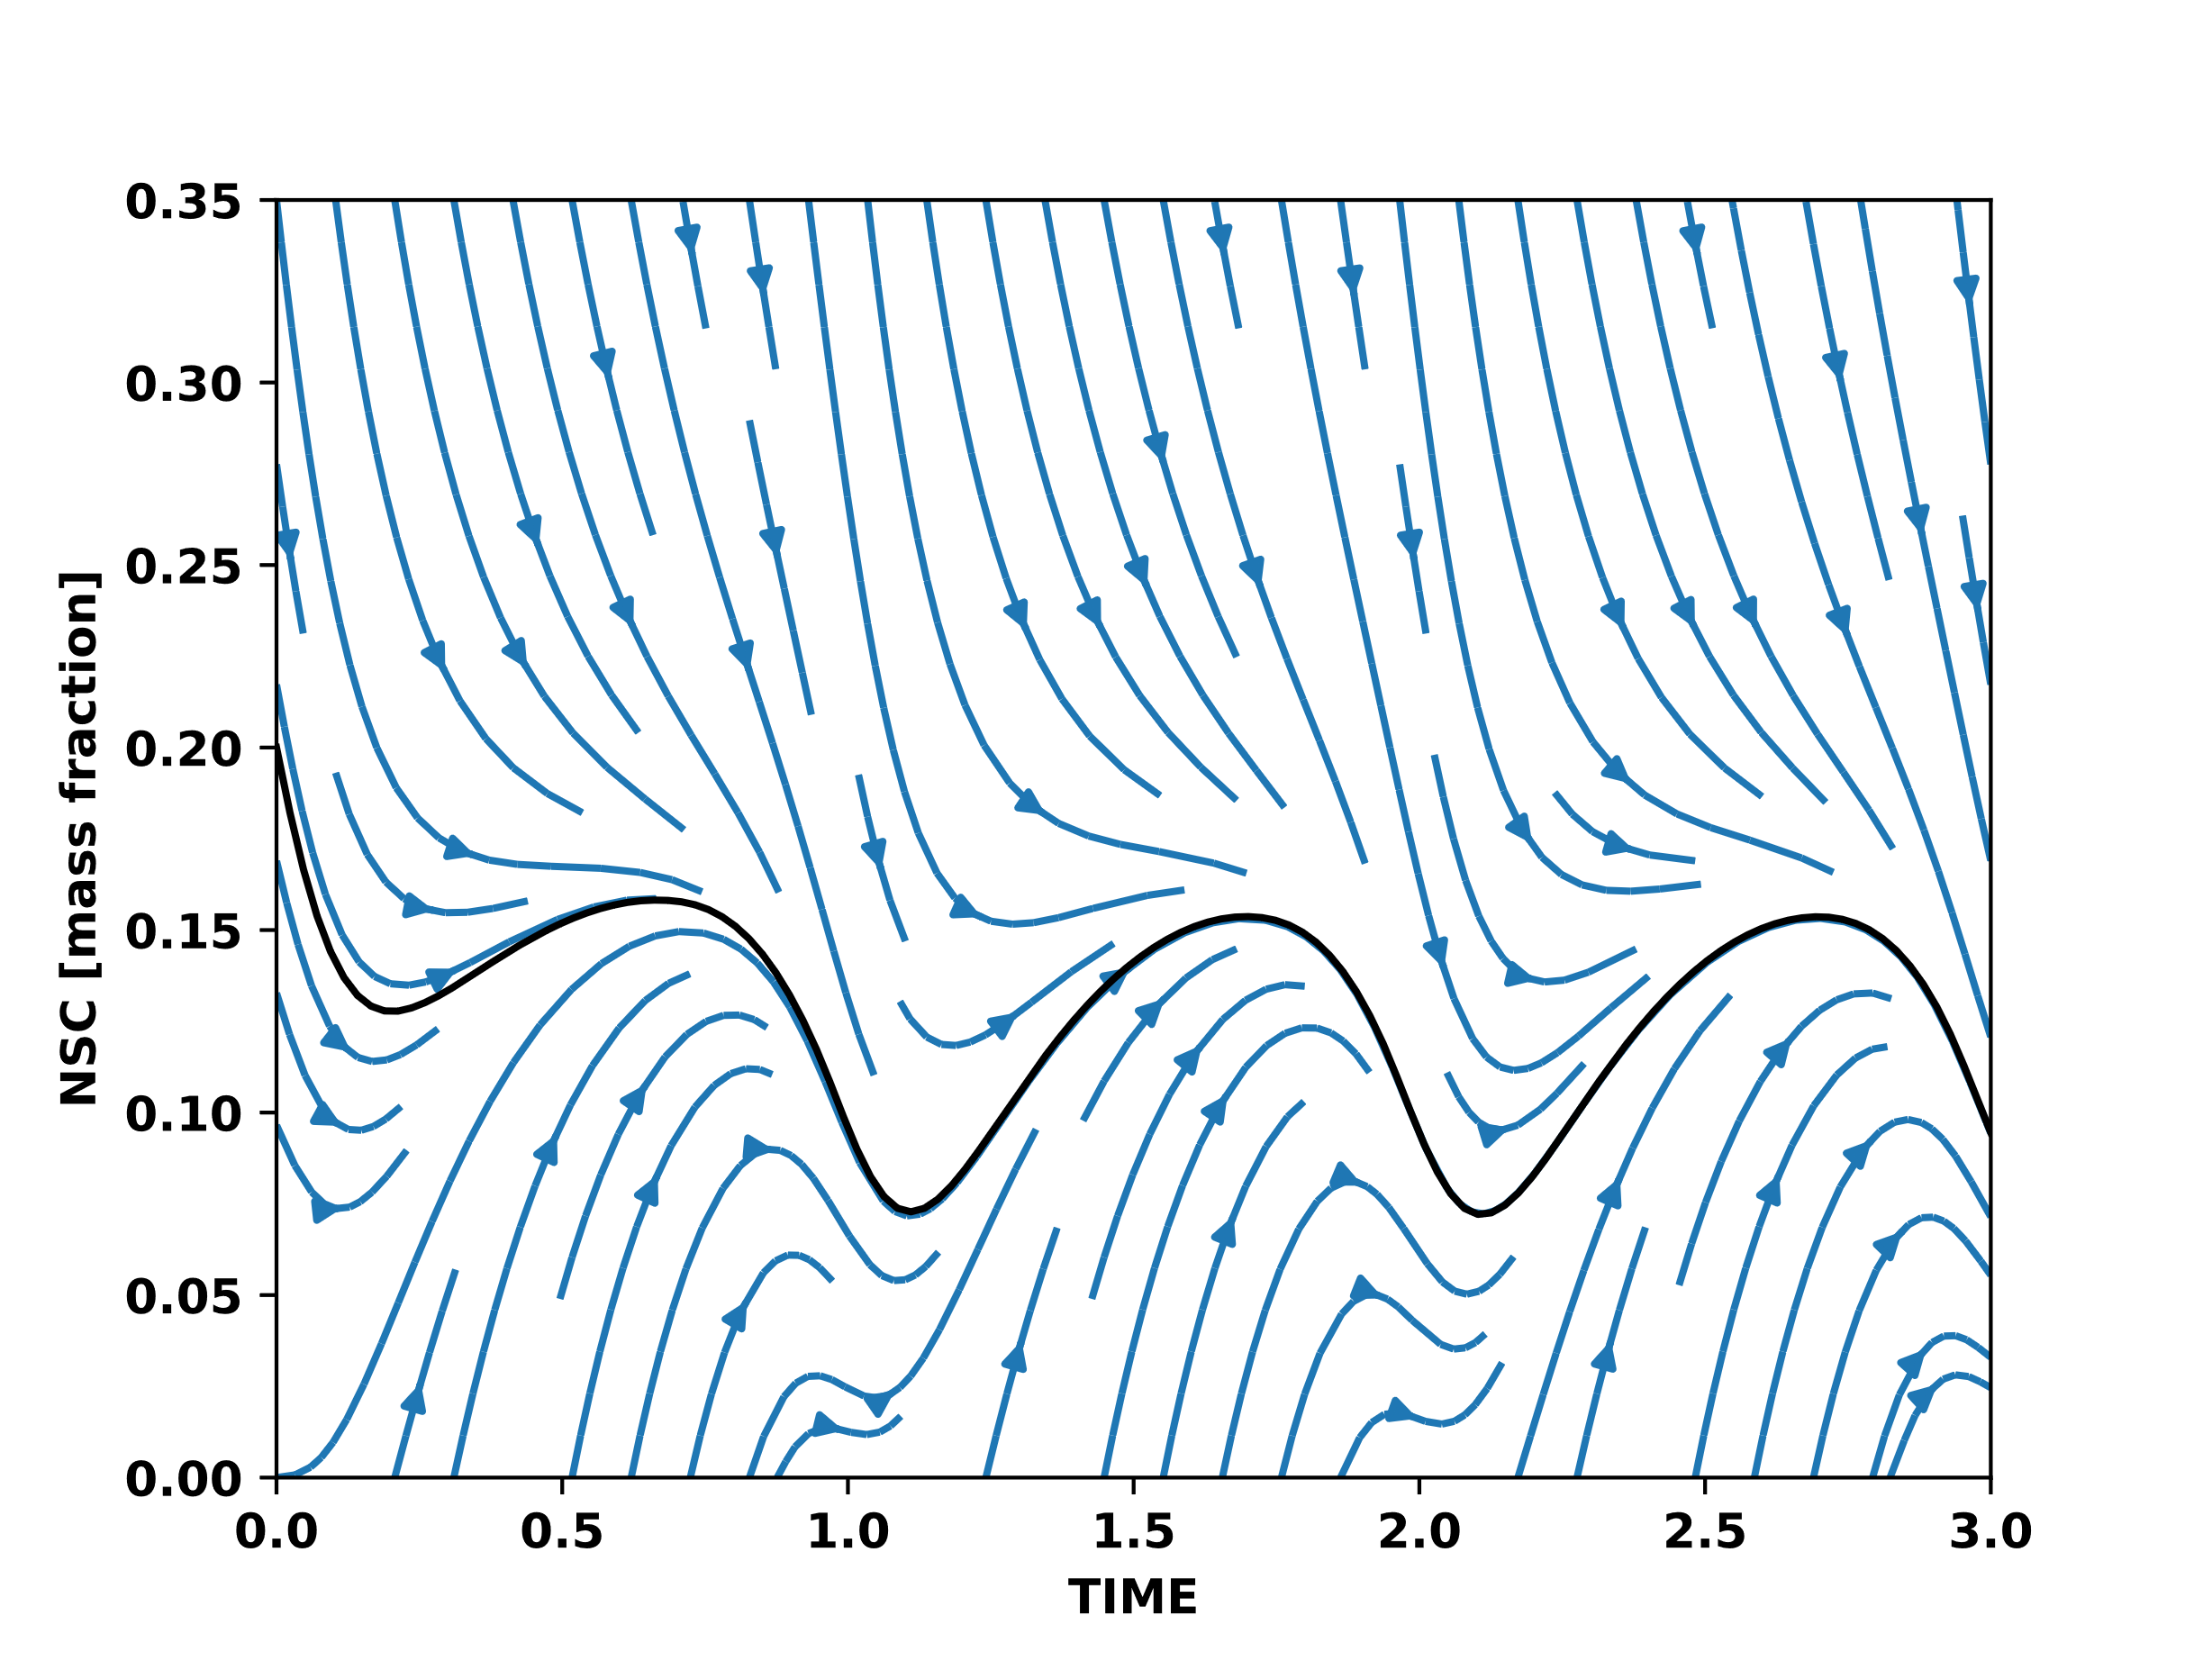
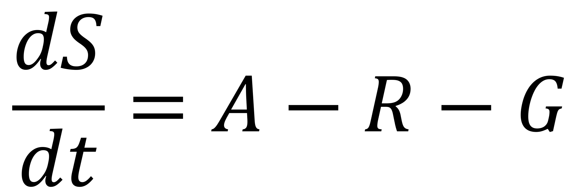
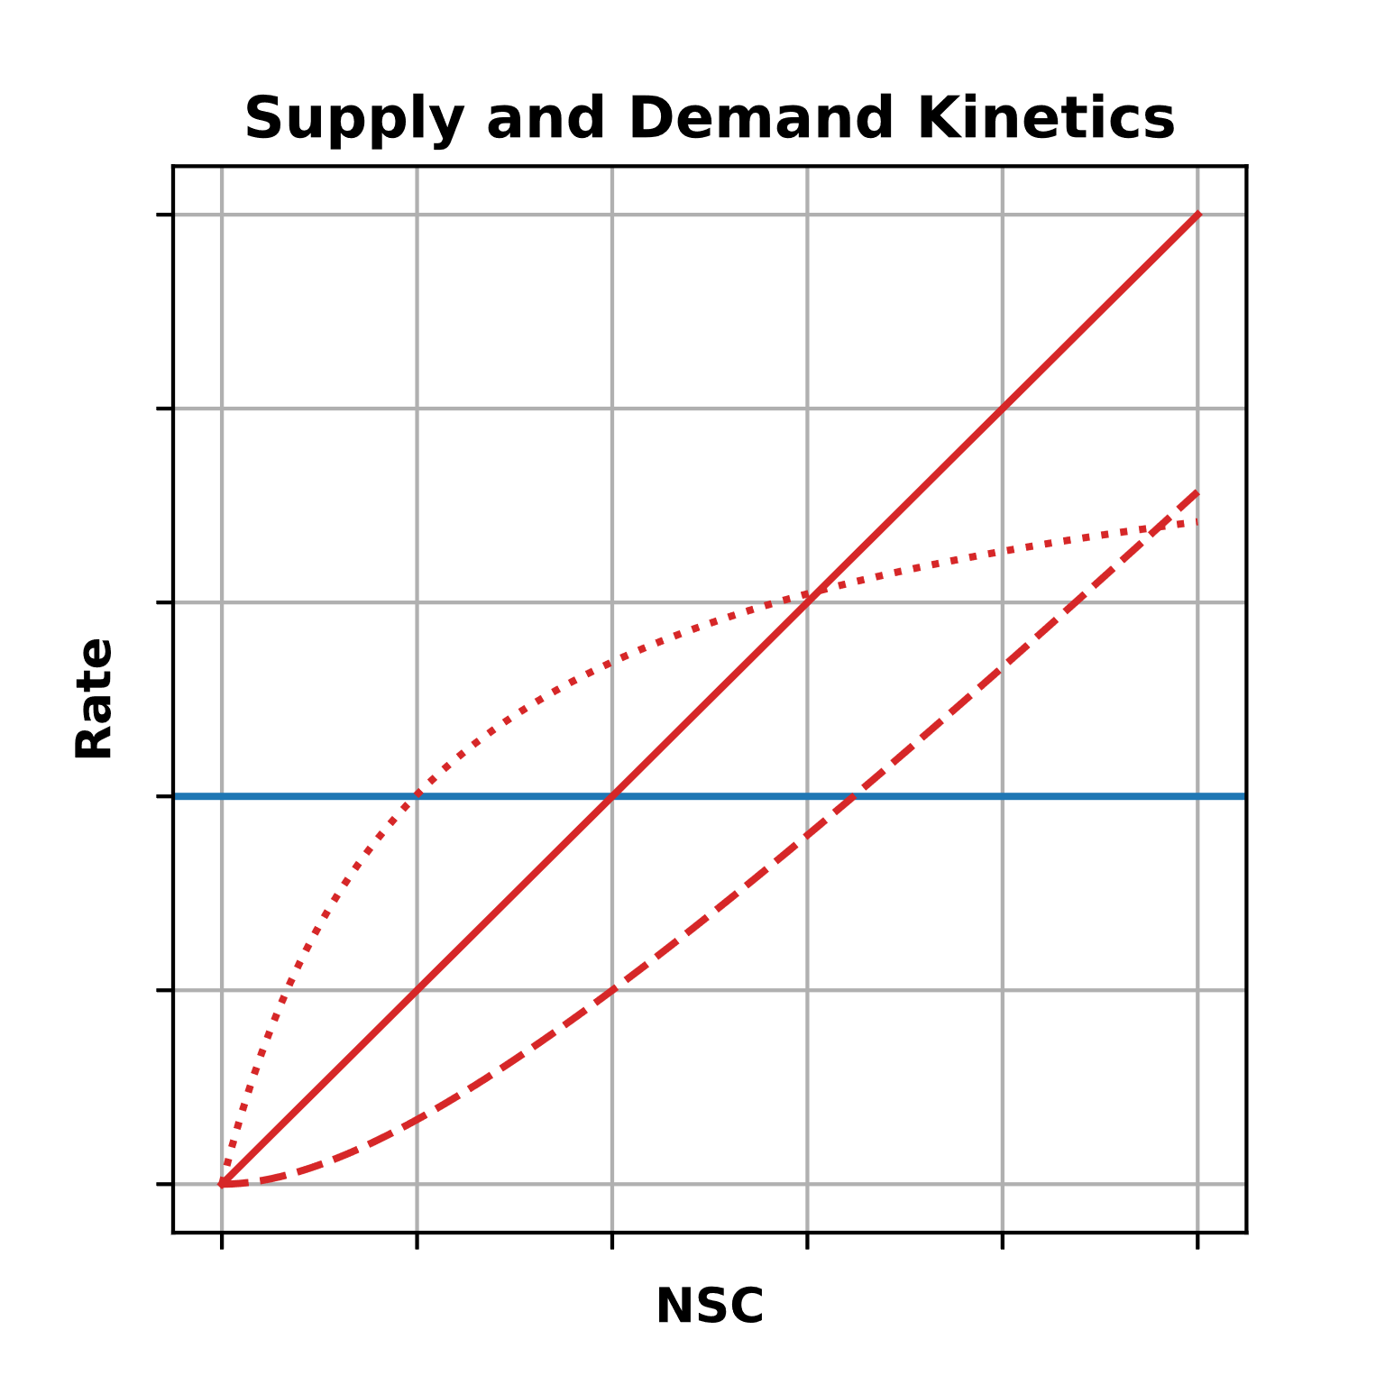

Slide 24
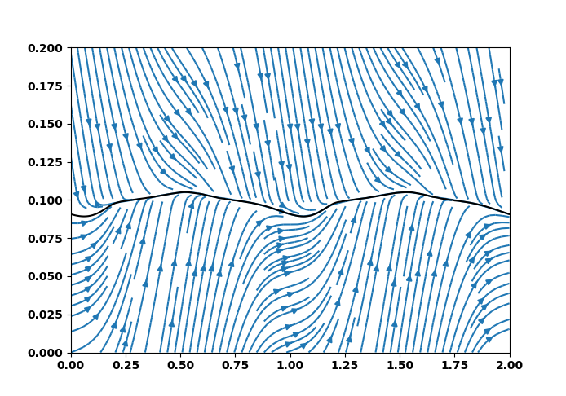
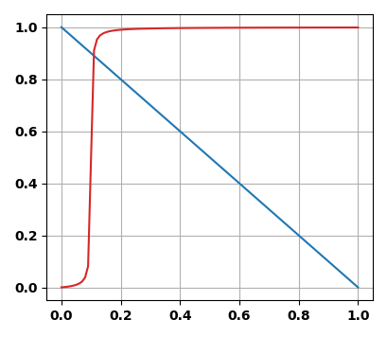
Homeostatic dynamics
Demand Rate
Supply Rate
NSC (mass fraction)
Time (y)

Slide 26
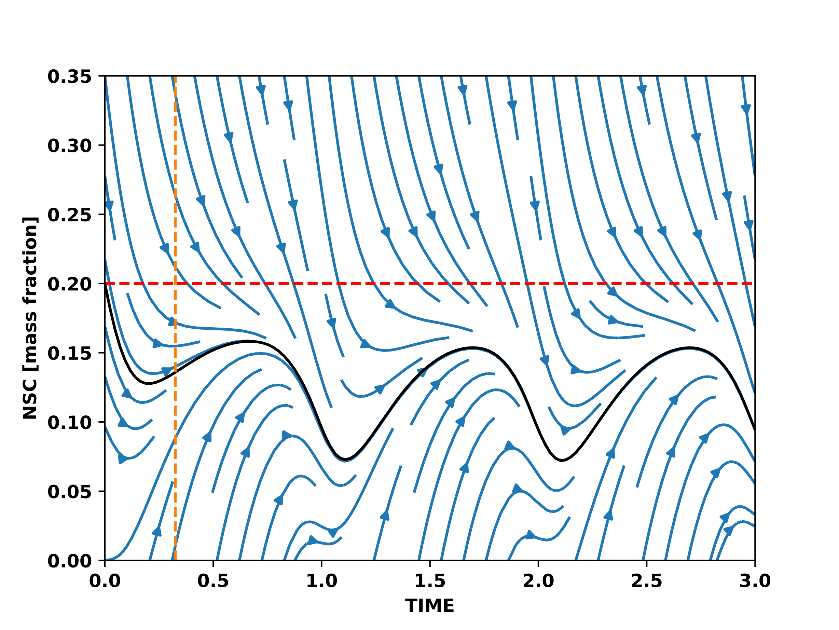
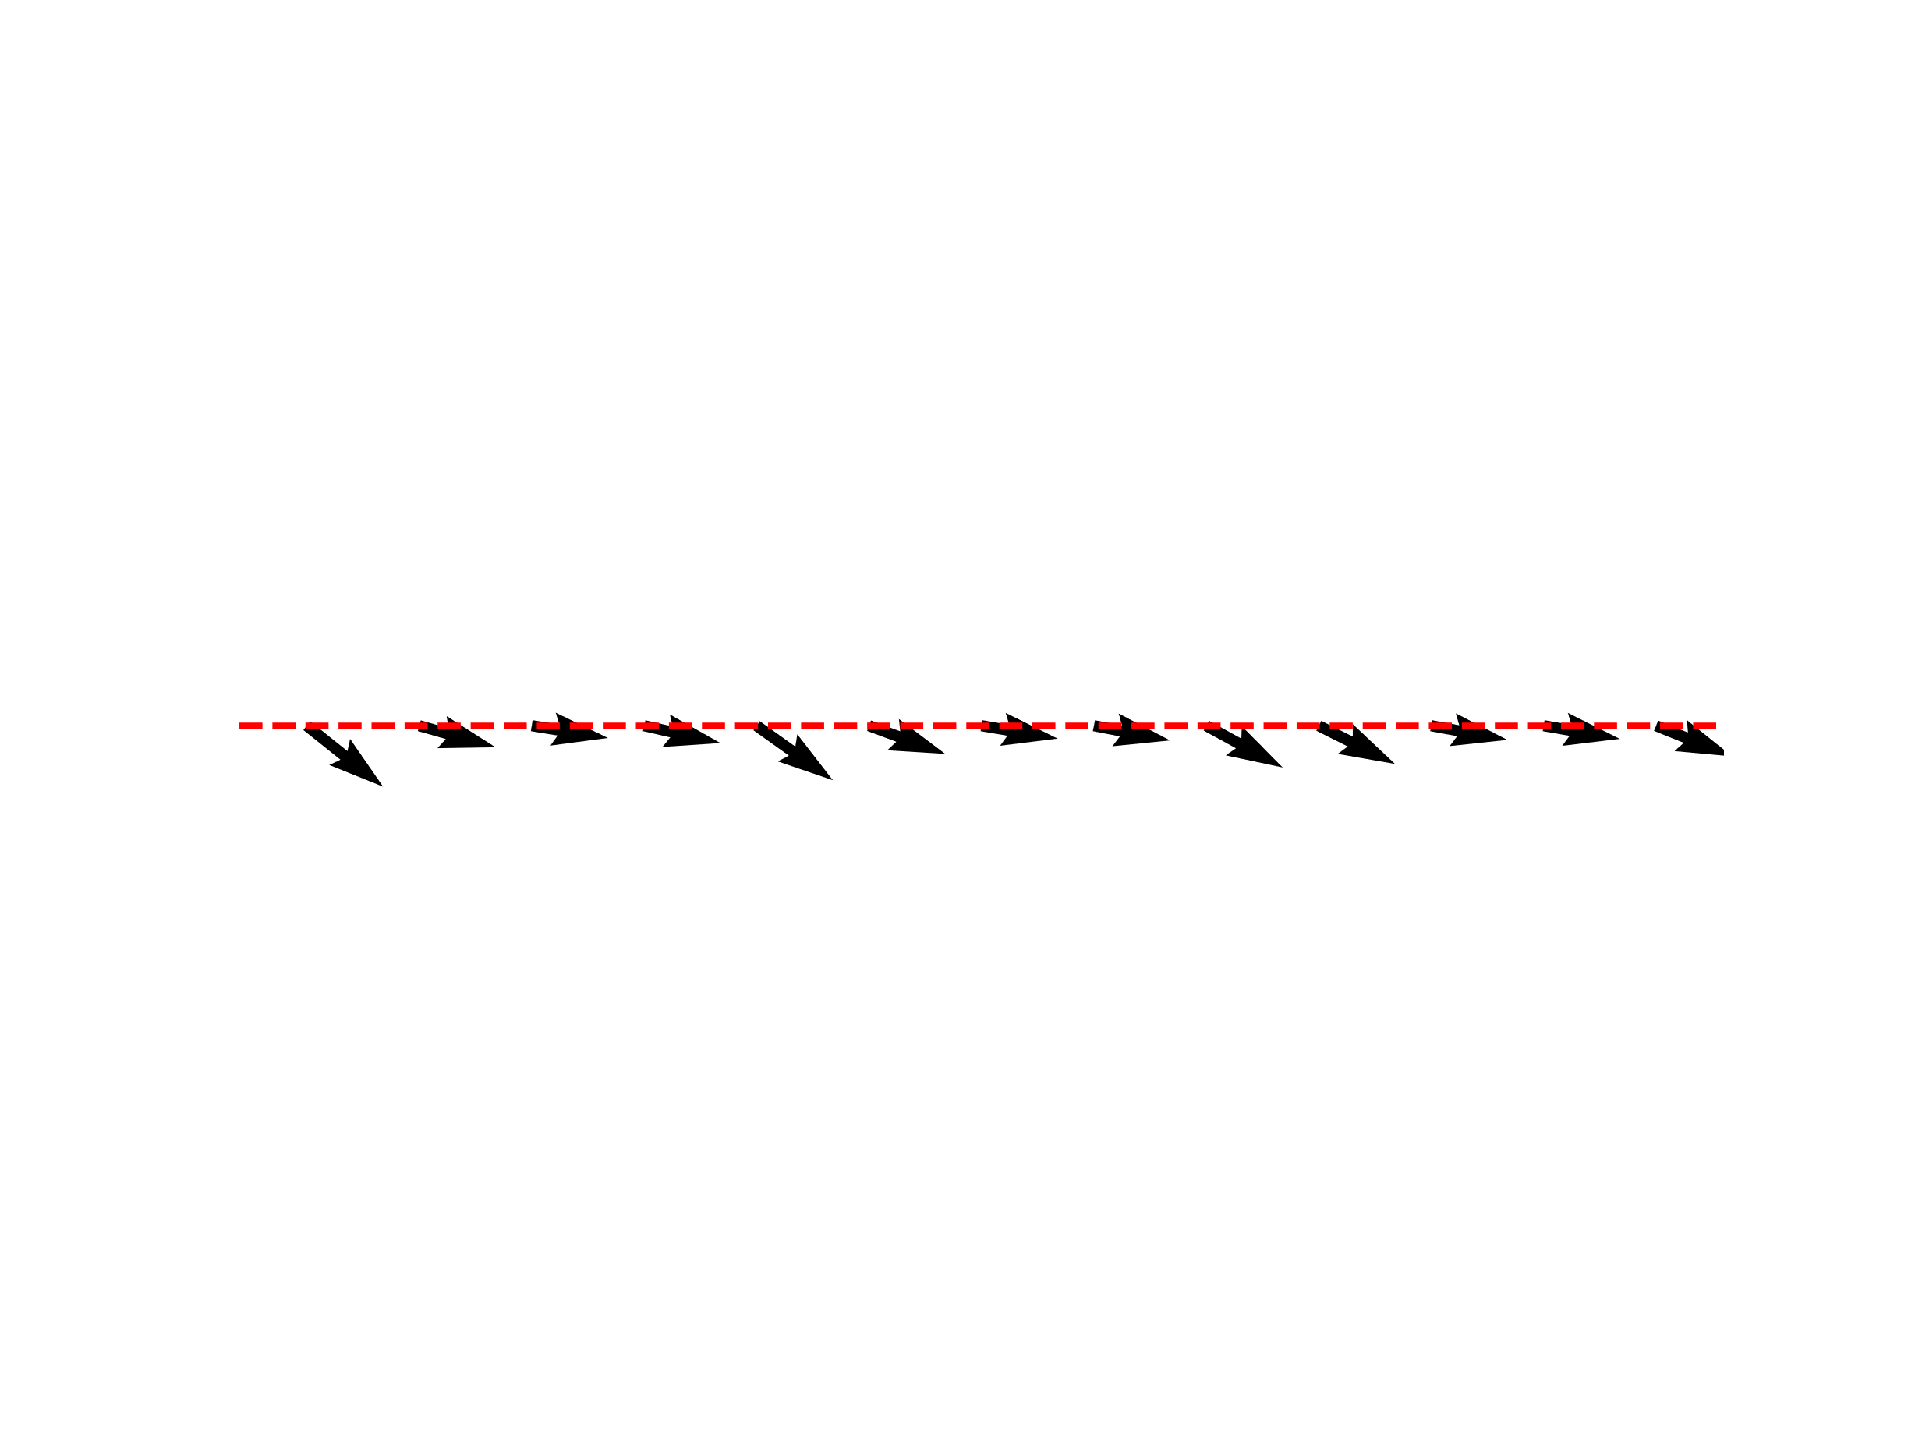
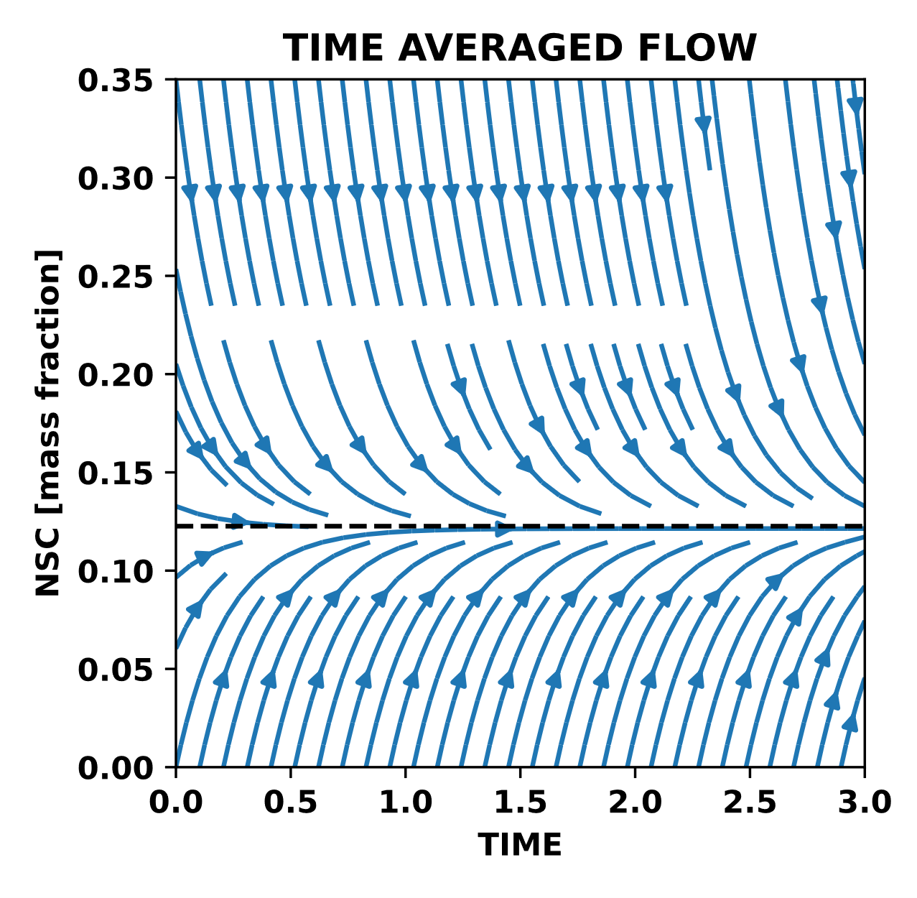

Slide 27
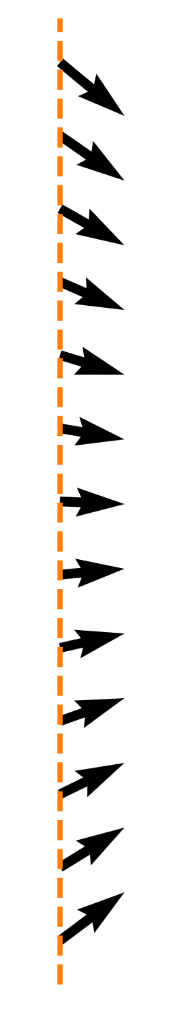

Slide 28
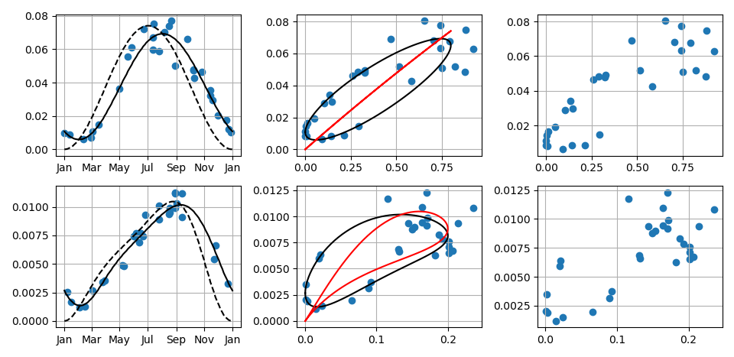

Slide 29
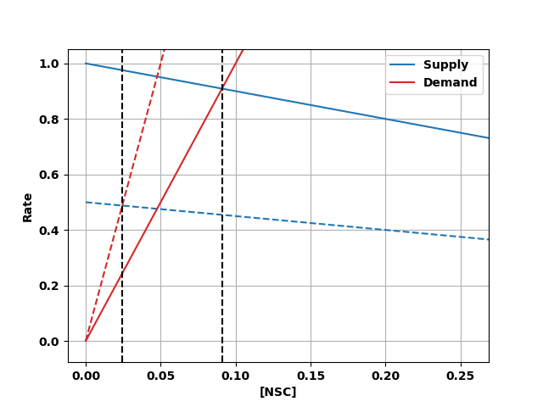
Photosynthesis = Supply
Adjustable
Respiration + Growth = Demand

